Slide 1
WHAT EXACTLY IS ORACLE EXALYTICS?

Slide 2
AGENDA
What Exactly Is Exalytics?
Exalytics At A Glance
The Exa Family
Do We Need Exalytics?
Hardware & Software
Times Ten
Performance Measurements
What exactly is Oracle Exalytics?

Slide 3

EXALYTICS AT-A-GLANCE
What Exactly is Exalytics?

Slide 4
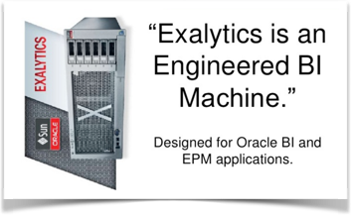
WHAT IS EXALYTICS?
Exalytics At-A-Glance
What exactly is Oracle Exalytics?

Slide 5
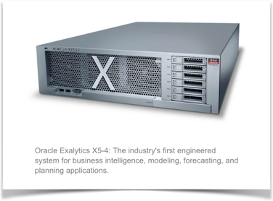
Scoop on Exalytics
Exalytics At-A-Glance
First BI appliance designed for Oracle BI and EPM applications
Single server optimized for in-memory analytics
Speed-of-thought analysis with simplicity
Requires no application redesign or reengineering
Part of Oracle’s “Exa” family
What exactly is Oracle Exalytics?

Slide 6
THE EXA FAMILY
What Exactly Is Exalytics?

Slide 7
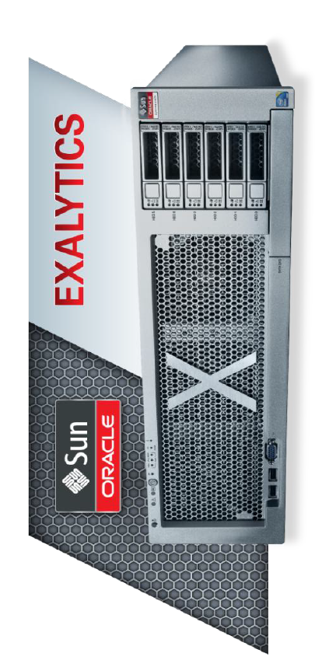


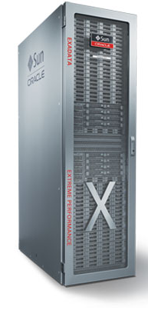
Oracle’s EXA Family
The EXA Family
EXADATA
EXALOGIC
Data Warehousing
OLAP
Enterprise Apps
High Availability
Analytics
Sub-Second Response
What exactly is Oracle Exalytics?
Notes:
Exadata
Optimized for DW/OLTP Load
The ideal consolidation platform
Exalogic
Optimized to run enterprise applications.
Pre-engineered high availability.
Exalytics
Optimized for Analytics
Consistent sub-second Response

Slide 8
EXADATA OVERVIEW
The Exa Family
Pre-integrated optimized Oracle database platform
Extreme performance for DW and OLTP
Highly scalable and secure
Intelligent technologies
For DW – 10X query performance.
For OLTP – 10x more concurrent users
What exactly is Oracle Exalytics?
Notes:
Pre-integrated optimized Oracle database platform.
Extreme performance for data warehousing and OLTP applications.
Highly scalable and secure.
Intelligent technologies – Smart Scan, Smart Flash Cache, Hybrid Columnar Compression and Infiniband Network.
The benefits include –
For Datawarehouse – 10X query performance.
For OLTP systems – 10x more concurrent users.

Slide 9
EXALOGIC OVERVIEW
The Exa Family
World’s first engineered system for Java, Oracle, or Enterprise applications
Foundation for secure private cloud
Unlimited scale & unbeatable performance
Pre-optimized and pre-configured servers and software
A combination of state-of-art technologies
What exactly is Oracle Exalytics?
Notes:
World’s first engineered system for Java, Oracle or Enterprise applications.
Foundation for secure, mission-critical private cloud
Virtually unlimited scale, unbeatable performance, and previously unimagined management simplicity.
Complete package of pre-optimized and pre-configured servers and software.
A combination of state of art technologies all together make it one of the best performing engineered system.

Slide 10
DO WE NEED EXALYTICS?
What Exactly is Exalytics?

Slide 11
Common BI Solution Roadblocks
Do we need Exalytics?
Multiple Vendors
Support Issues
Performance Challenges
Replicated Data
Too many servers
User Acceptance
What exactly is Oracle Exalytics?
Notes:
A vision of delivering fast, interactive, insightful analytics.
Here are some of the roadblocks in rolling out a BI solution –
Multiple Vendors – Support Issues
Performance Challenges
Replicated Data
Too many servers
User Acceptance

Slide 12
Engineered BI System
Do we need Exalytics?
Sub-second response time
OBIEE with hardware acceleration and optimization
Memory with optimization
In-Memory Database (Times Ten)
Adaptive In-Memory Caching
Columnar Compression
Infiniband connectivity
A plug and play architecture
What exactly is Oracle Exalytics?
KPI Partners Slide Template
Notes:
Engineered BI System – Optimized Hardware and Software for sub-second analysis response time.
OBIEE Foundation Suite with hardware acceleration and optimization.
Abundance Computation Power, Memory with optimization.
In-Memory Database (TimesTen) with Adaptive In-Memory Caching and Columnar Compression.
Infiniband connectivity to Exadata / Exalogic.
A plug and play architecture.

Slide 13
HARDWARE & SOFTWARE
What Exactly is Exalytics?

Slide 14
Exalytics Hardware
Hardware & Software
Oracle’s Sun Fire X4470M2 server with 1 Terabyte of RAM
4 Intel Xeon processor E7-4800 (40 cores).
2 (40 Gb/s InfiniBand and 10 Gb/s Ethernet)
6 * 600 GB Hard disks (3.6 TB)
Integrated Lights Out Management
An always On Service Processor
A configuration of Sun Fire.
What exactly is Oracle Exalytics?

Slide 15
Hardware & Software
Exalytics Software
Oracle Exalytics Software Media Pack v1 for Linux x86-64
Exalytics base image based on Exalogic 1.0.0.3
Exalytics Configuration Tool
BI Foundation Suite 11.1.1.6.0
Oracle Times Ten for Exalytics 11.2.2.2
EPM Suite 11.1.2.1
Essbase opatch for EPM 11.1.2.2.000
What exactly is Oracle Exalytics?

Slide 16
Hardware & Software
Hardware & Software Optimization
The following techniques help achieve the lightning fast performance:
In-Memory Adaptive Data Mart
In-Memory Intelligent Cache
In-Memory Cubes
What exactly is Oracle Exalytics?

Slide 17
ORACLE TIMES TEN
What Exactly Is Exalytics?

Slide 18
Oracle Times Ten
In-Memory Relational Database
One Times Ten DB per Exalytics machine
Enhanced with Columnar Compression, Grouping Operators
Supports multiple caching options
High Availability
What exactly is Oracle Exalytics?
Notes:
An optimized in-memory relational database.
Enhanced with Columnar Compression, Grouping Operators .
For smaller datasets - deployed as a standalone database
For larger datasets – deployed with Oracle as part of Oracle In-Memory Database Cache.
Supports multiple Caching Options.
Support High Availability using In-Memory Database Cache Grid.
Single TimesTen database per Exalytics machine.

Slide 19
ORACLE BI ON EXALYTICS
What Exactly is Exalytics?

Slide 20
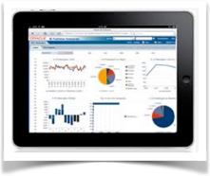
OBIEE on Exalytics
Oracle BI On Exalytics
Hardware Acceleration Flag
Auto-Complete for Dashboard Prompts or Prompt Search Dialog box
Supports multi-panel trellis charts and micro charts
Summary Advisor
Aggregate Persistence for Times Ten In-Memory DB for Exalytics
What exactly is Oracle Exalytics?

Slide 21
Oracle BI on Exalytics
Features only found in Exalytics
BI Server
Optimizations driven by Oracle hardware acceleration flag
Summary Advisor
Aggregate Persistence for Times Ten In-Memory DB for Exalytics
Essbase
Optimizations driven by hardware acceleration flag
ASO / BSO Optimizations
Oracle Time-Ten In-Memory Database
OLAP Grouping
Columnar Compression
What exactly is Oracle Exalytics?

Slide 22
PERFORMANCE
What Exactly Is Exalytics?

Slide 23
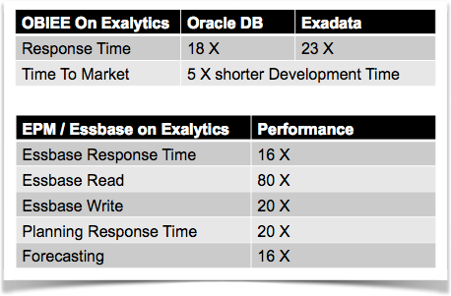
Performance
Performance Comparisons
What exactly is Oracle Exalytics?

Slide 24
CONCLUSION
What Exactly is Exalytics?

Slide 25
If you need….
Conclusion
Consistent sub-second Report response time.
Better user acceptance.
Highly interactive and complex reporting needs .
Consolidate multiple BI systems
Reduce planning time cycle and re-calculate data faster.
Single Vendor strategy.
Exalytics is the answer.
What exactly is Oracle Exalytics?

Slide 26
About MindStream Analytics
MindStream Analytics is a leading consulting and managed services provider with a proven track record for helping leading global companies address their enterprise challenges, focused on delivering sustainable profitability and competitive advantage.
Data is a new economic asset that is rapidly expanding and changing. You're challenged to figure out how to use it to your organization's advantage. We work collaboratively with our clients and bringing innovative strategies that enable organizations to gain competitive edge and win with data.
To contact us about how MindStream can help you win with data, call or email us:
800.497.0151
Sales@mindstreamanaltyics.com
www.mindstreamanalytics.com
What exactly is Oracle Exalytics?

